Slide 1

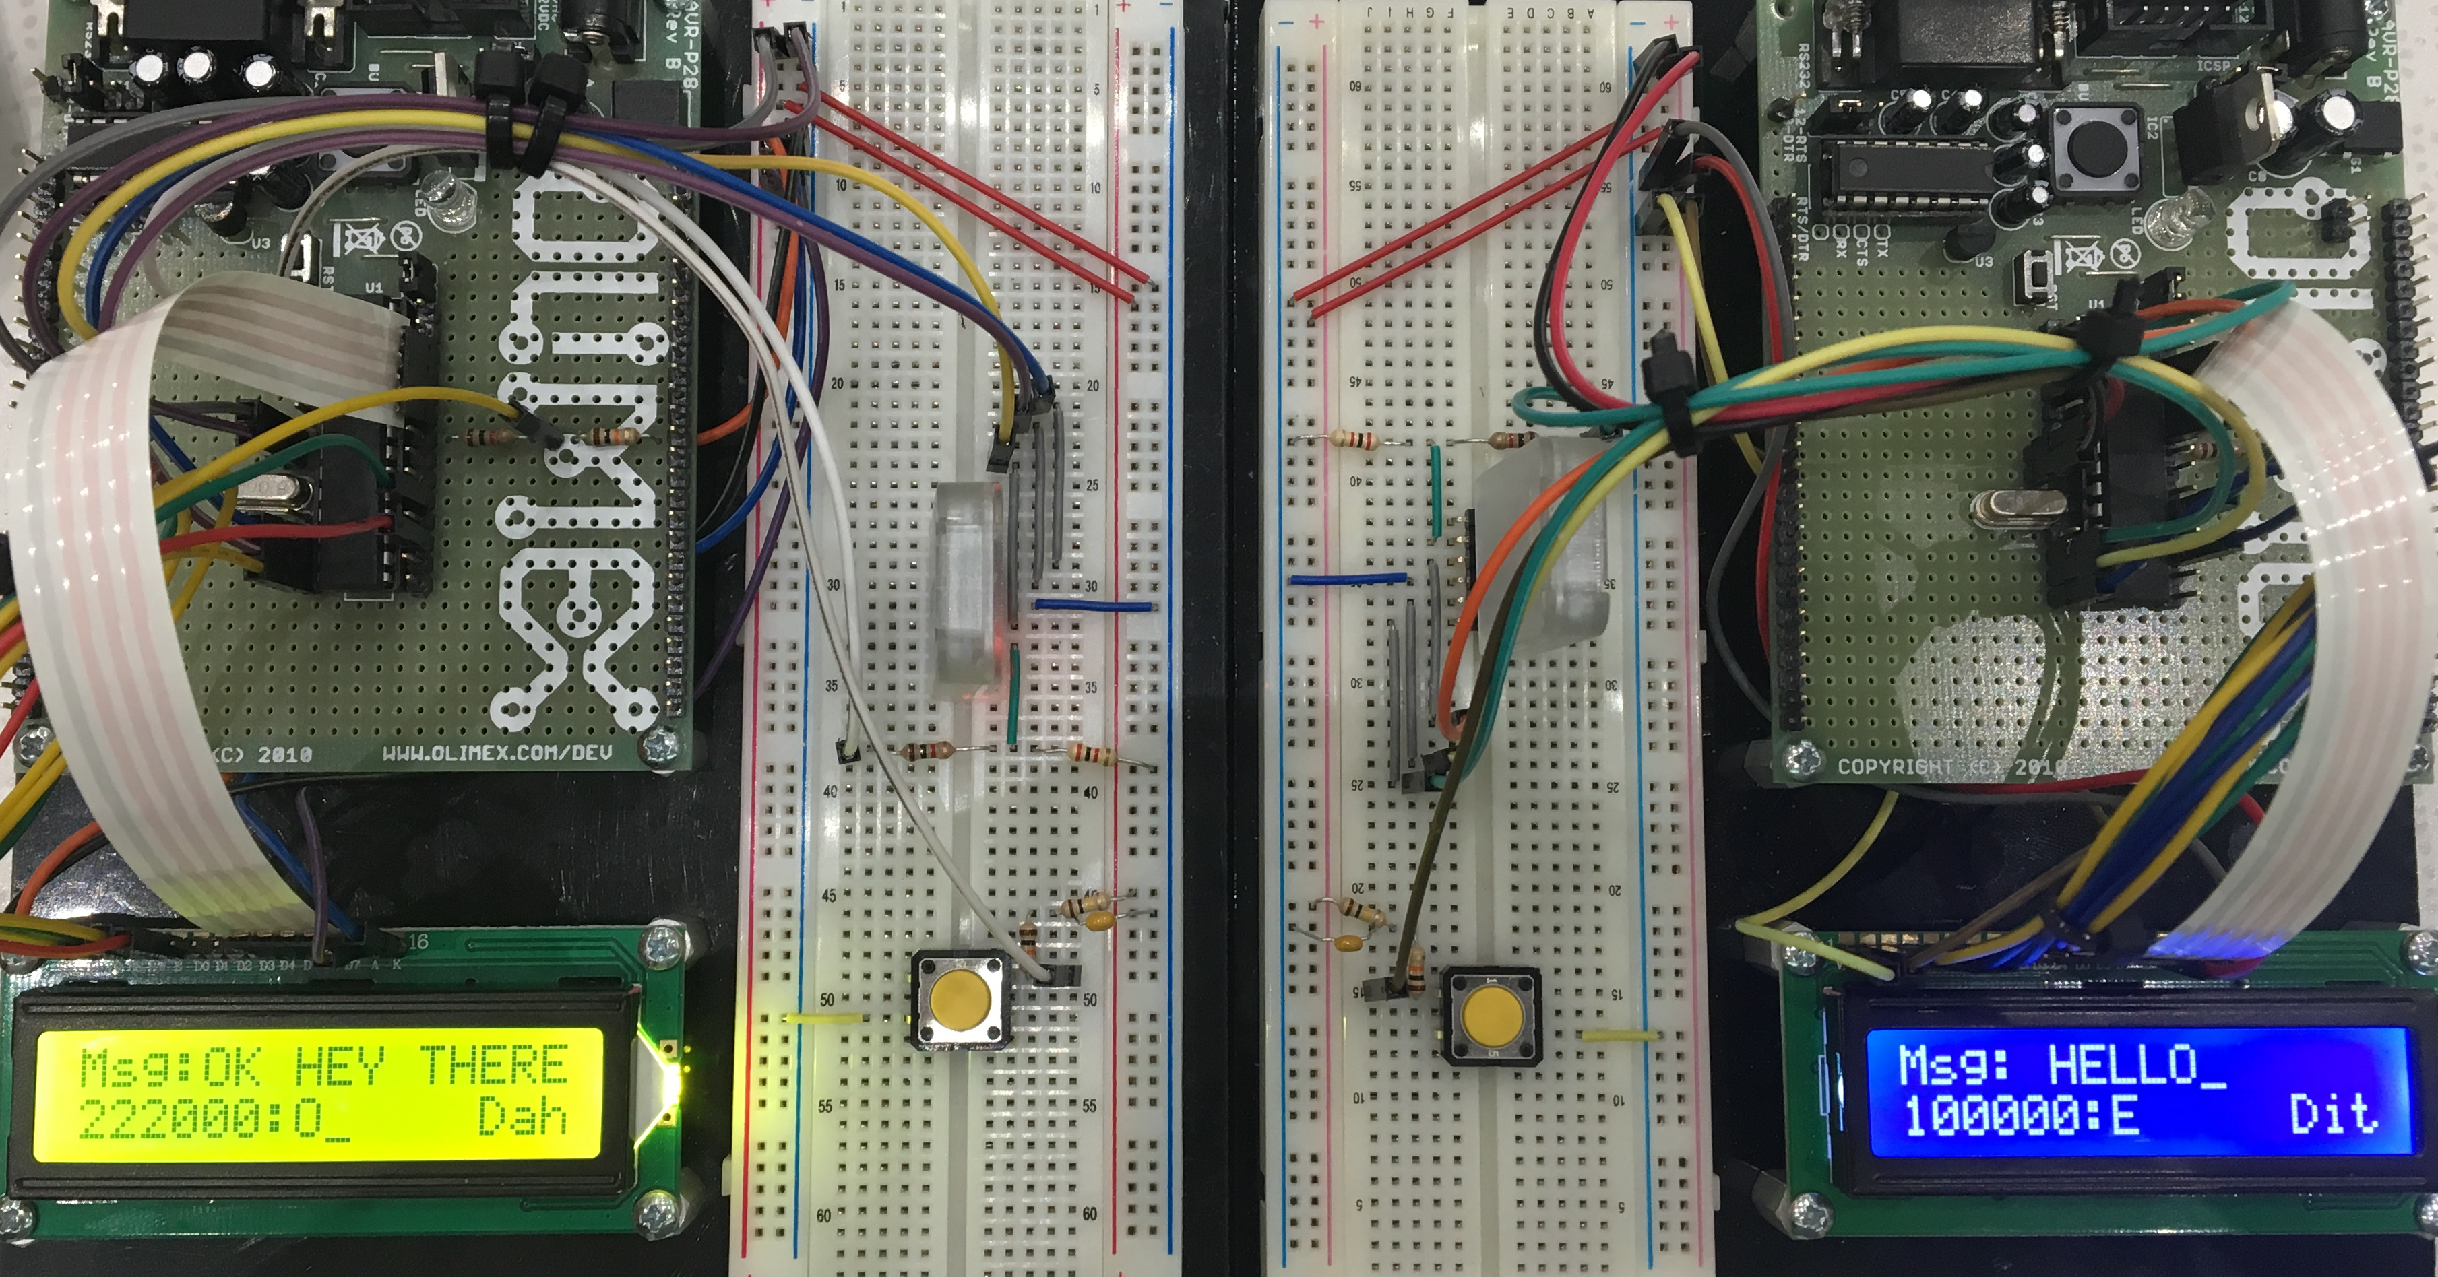
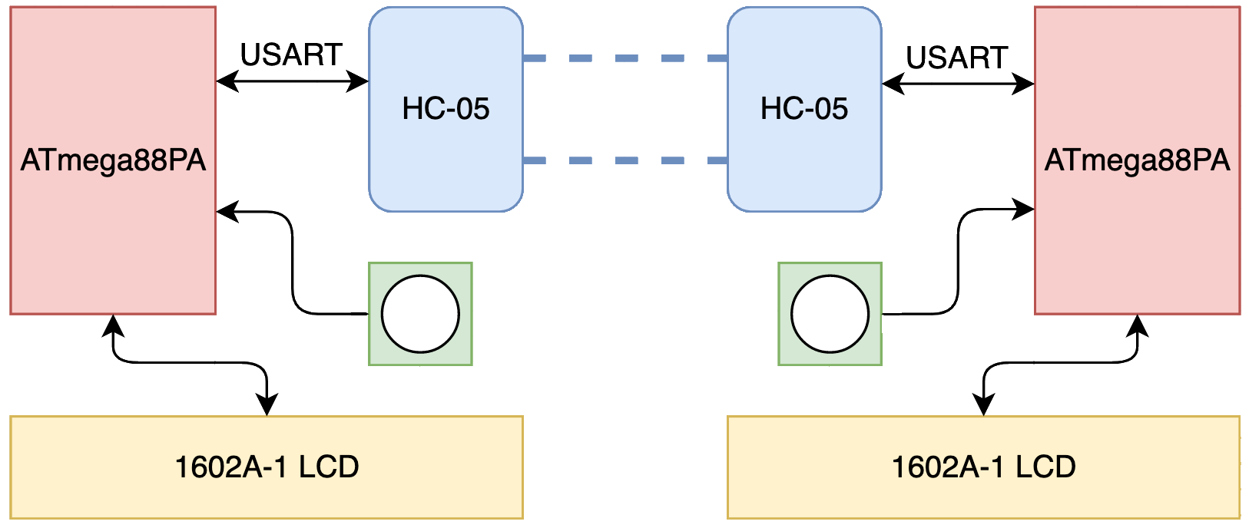
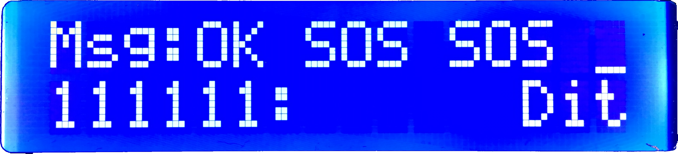
Morse Code Chat
23
Alexander Powers and Benjamin Mitchinson
Abstract
Our project was the design and creation of a discrete Morse Code communication system programmed on two ATmega88PA development boards. Using our solution, two users are able to communicate with one another by tapping out Morse Code on a button, which is then transmitted over Bluetooth to the LCD of the other user.
Image 1. Side by side of the two devices
System Design
Result
Our project is able to consistently and accurately interpret and transmit Morse code to another device each running the same compiled code. Because we’ve chosen to send communications one character at a time immediately as they’re entered by the user, there’s very little delay in transmission, and interaction between the two devices is seemingly instant.
Figure 1. System Overview
The button is the primary input signal for the system, which the ATmega88PA detects and interprets through a timer interrupt. This decoded Morse Code is then sent via the USART communication protocol to the HC-05 Bluetooth module, which then forwards the message to the other board’s HC-05 module. Once received by the other ATmega88PA, the Morse code is displayed on the 1602A-1 LCD. The LCD also displays the current Morse Code bits, and the previous button press interpretation.
Image 2. User view during use
Additionally, we were able to use the binding functionality of the HC-05, to ensure that messages will only be transmitted between our two devices, ensuring that other Bluetooth communications will never interrupt our transmissions.
Lessons Learned
Conclusion
Reflecting on final physical hardware design, our solution would be more marketable if it was contained in a compact form, as opposed to being left on the development board and tethered to an outlet power source. The components are small enough to be wired to one board, and using a battery to power them all would result in an entirely portable device.
Our completed solution achieves exactly what we sought to accomplish. The pairing process of the HC-05 devices is faster and more reliable than originally anticipated, resulting in a consistent and accurate transmission of the Morse Code. We also designed our solution to be flexible to user tapping speed by allowing the Farnsworth unit to be changed to match the users preference. This project has sparked our interest in embedded systems, and we intend to convert this into a handheld, battery powered system over the summer!
Acknowledgments
USART Library (https://www.electronicwings.com)
LCD Library (http://tinyurl.com/peterfleury)
Farnsworth Unit (https://morsecode.scphillips.com/timing.html)
Standard AVR Libraries (interrupt.h/delay.h/io.h)
ECE:3360 Embedded Systems 2019
The University of Iowa

